Slide 1
2017 NCAE
Test Administration Guidelines

Slide 2
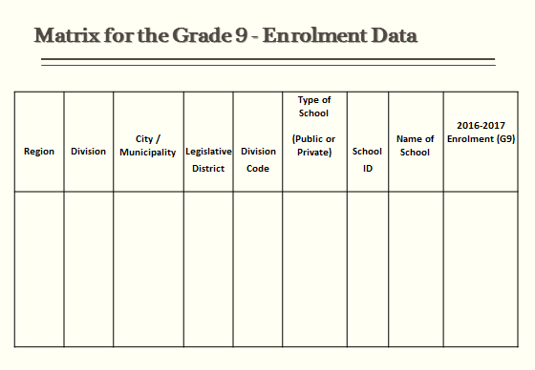

Slide 3
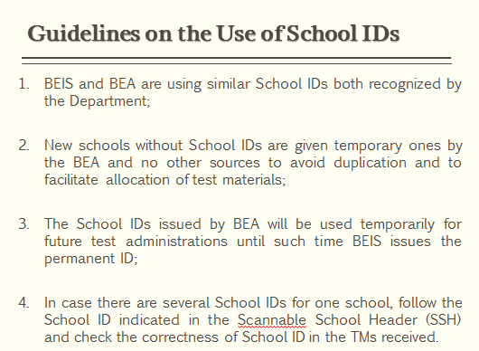

Slide 4
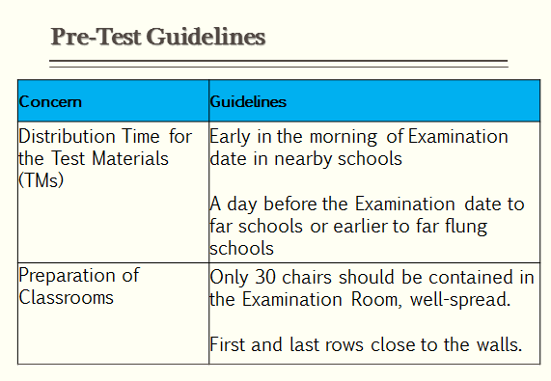

Slide 5
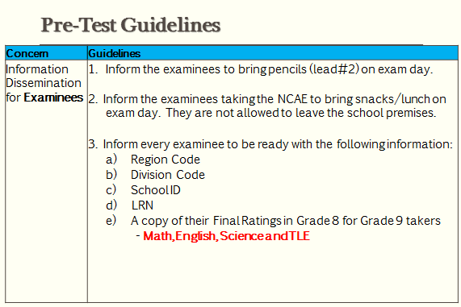

Slide 6
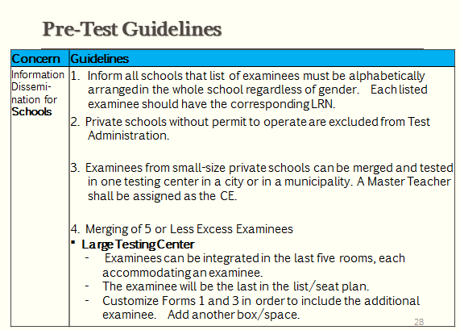

Slide 7
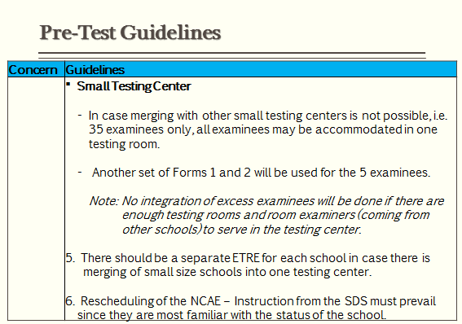

Slide 8
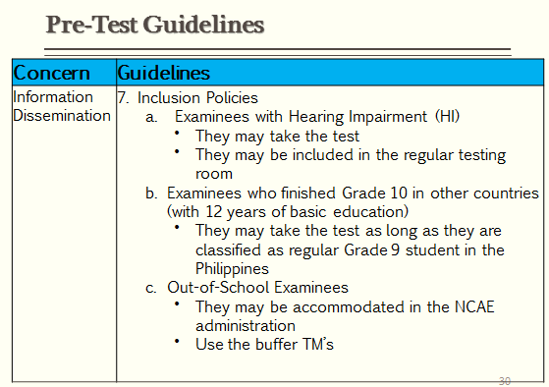

Slide 9
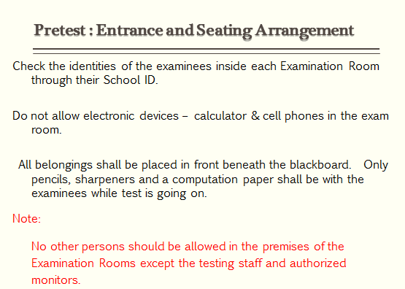

Slide 10
Allocation of Test Materials
I. Test Booklets. There shall be two (2) booklets for NCAE: Test Booklets A and B.
Booklet A contains the General Directions, Examinee’s Descriptive Questionnaire (EDQ), General Scholastic Aptitude (GSA), Technical-Vocational-Livelihood and Sports subtests.
Booklet B contains the Academic Tracks (HUMMS, STEM and ABM), Arts and Design and Occupational Interest Inventory subtests.

Slide 11
II. Answer Sheets. The examinees shall use scannable Answer Sheets designed specifically for NCAE.
IMPORTANT: Every examinee must receive two sheets of AS with the same serial number- one for Day 1 and the other for Day 2. The RE must check that the serial numbers of the two sheets are identical.

Slide 12
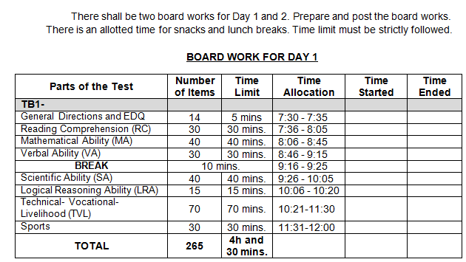
Board Work

Slide 13
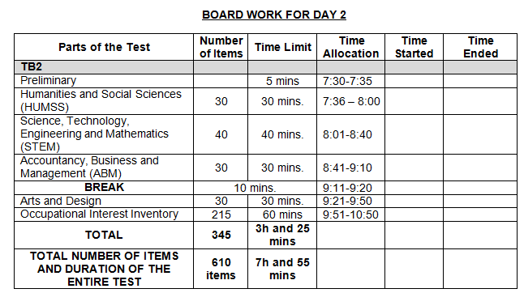
Board Work

Slide 14
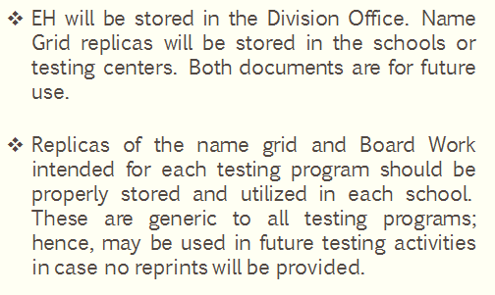
On the Storage of Examiner’s Handbook and Replicas of Name Grid

Slide 15
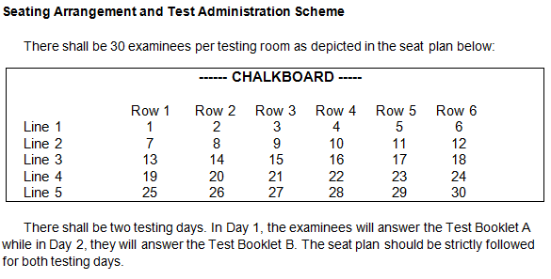

Slide 16
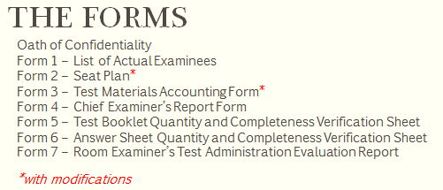

Slide 17
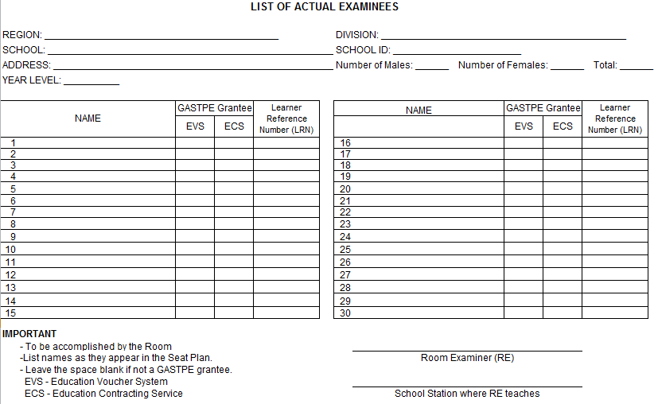
FORM 1

Slide 18
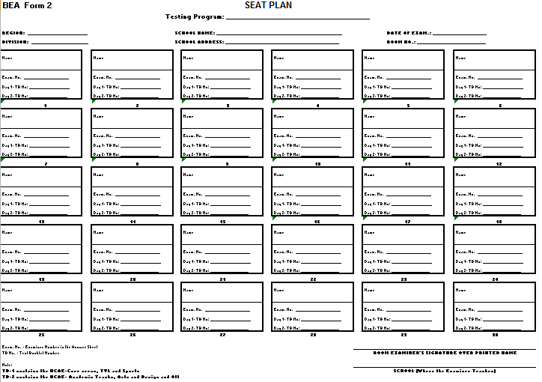
FORM 2

Slide 19
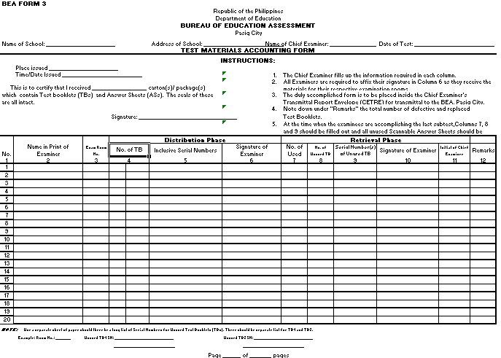
FORM 3

Slide 20
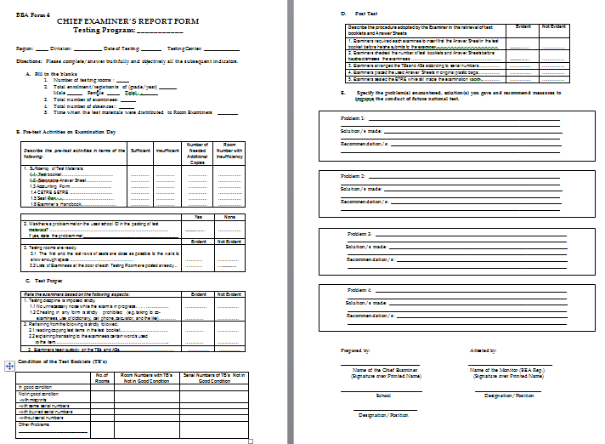
FORM 4

Slide 21
Forms 5 and 6

Slide 22
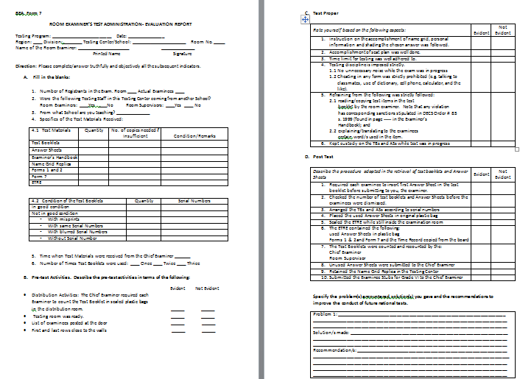
Form 7

Slide 23
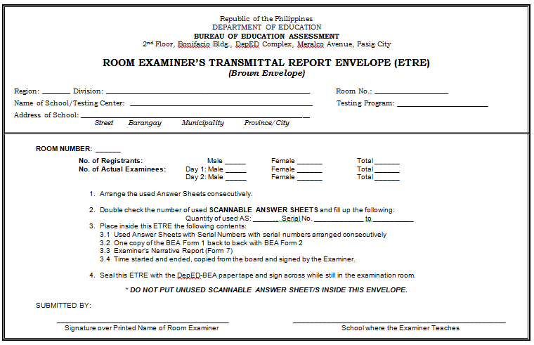
ETRE

Slide 24
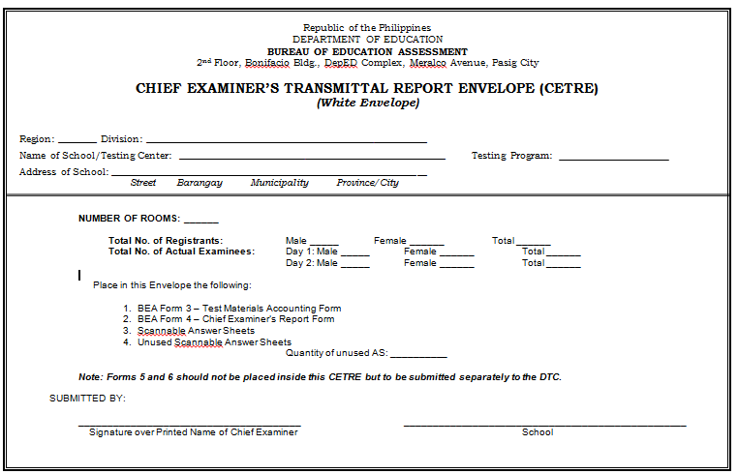
CETRE

Slide 25
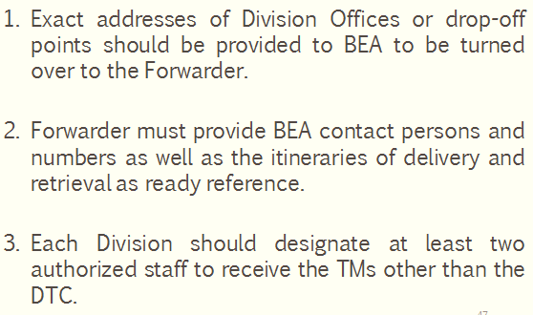
The Forwarder of the Test Materials

Slide 26
The Forwarder of the Test Materials
The neighboring Divisions in the Region should establish a network of communication.
a. Every receiving Division should take note of Forwarder’s contact number and the date and time TMs will be retrieved
b. The next division to receive the TMs from the Forwarder should be alerted by the Division immediately after receiving its TMs while informing also the Forwarder that the next division to receive has been alerted already.
The same procedure will be followed in the retrieval of TMs
Accomplish the Evaluation form on the Performance of Forwarder and submit thru email: bea.od@deped.gov.ph

Slide 27
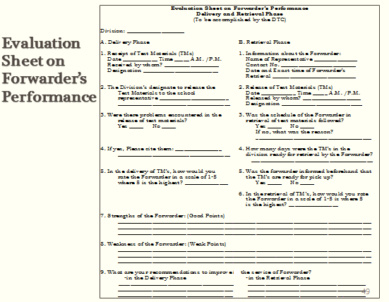

Slide 28
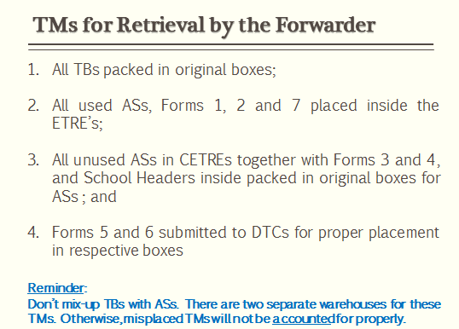

Slide 29
